Slide 1
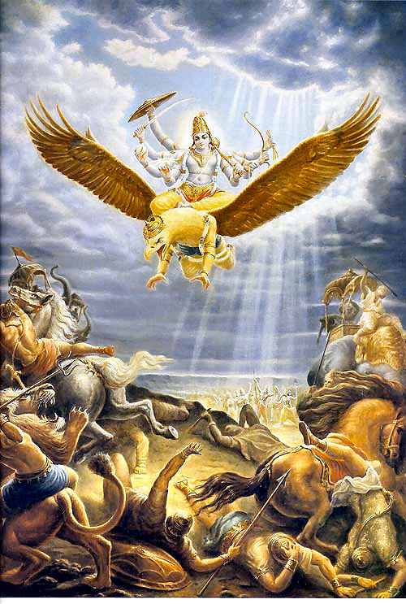
SB 3.28.24

Slide 2
SB 3.28.24
ūrū suparṇa-bhujayor adhi śobhamānāv
ojo-nidhī atasikā-kusumāvabhāsau
vyālambi-pīta-vara-vāsasi vartamāna-
kāñcī-kalāpa-parirambhi nitamba-bimbam

Slide 3
Synonyms:
ūrū — the two thighs; suparṇa — of Garuḍa; bhujayoḥ — the two shoulders; adhi — on; śobhamānau — beautiful; ojaḥ-nidhī — the storehouse of all energy; atasikā-kusuma — of the linseed flower; avabhāsau — like the luster; vyālambi — extending down; pīta — yellow; vara — exquisite; vāsasi — on the cloth; vartamāna — being; kāñcī-kalāpa — by a girdle; parirambhi — encircled; nitamba-bimbam — His rounded hips.

Slide 4
Translation:
Next, the yogi should fix his mind in meditation on the Personality of Godhead’s thighs, the storehouse of all energy. The Lord’s thighs are whitish blue, like the luster of the linseed flower, and appear most graceful when the Lord is carried on the shoulders of Garuḍa. Also the yogī should contemplate His rounded hips, which are encircled by a girdle that rests on the exquisite yellow silk cloth that extends down to His ankles.

Slide 5
Purport:
The Personality of Godhead is the reservoir of all strength, and His strength rests on the thighs of His transcendental body. His whole body is full of opulences: all riches, all strength, all fame, all beauty, all knowledge and all renunciation. The yogī is advised to meditate upon the transcendental form of the Lord, beginning from the soles of the feet and then gradually rising to the knees, to the thighs, and finally arriving at the face. The system of meditating on the Supreme Personality of Godhead begins from His feet.

Slide 6
The description of the transcendental form of the Lord is exactly represented in the arcā-vigraha, the statue in the temples. Generally, the lower part of the body of the statue of the Lord is covered with yellow silk. That is the Vaikuṇṭha dress, or the dress the Lord wears in the spiritual sky. This cloth extends down to the Lord’s ankles. Thus, since the yogī has so many transcendental objectives on which to meditate, there is no reason for his meditating on something imaginary, as is the practice of the so-called yogīs whose objective is impersonal.

Slide 7
SB 3.28.24
Next, the yogi should fix his mind in meditation on the Personality of Godhead’s thighs, the storehouse of all energy. The Lord’s thighs are whitish blue, like the luster of the linseed flower, and appear most graceful when the Lord is carried on the shoulders of Garuḍa. Also the yogī should contemplate His rounded hips, which are encircled by a girdle that rests on the exquisite yellow silk cloth that extends down to His ankles.

Slide 8
Synonyms:
ūrū — the two thighs; suparṇa — of Garuḍa; bhujayoḥ — the two shoulders; adhi — on; śobhamānau — beautiful;
Notes:
ūrū —2 thighs
Uru = great, powerful
urukrama
guru
ūrū = greatest, most power limbs = thighs
suparṇa — of Garuḍa (wonderful, extraordinarily powerful wings)
We swing hand, paper move or candle blow out
Nectar, Kadru, demigods, wings and talons, wheel, 2 headed serpents, eyes burn, blinded
Eat nisadas, dust, open mouth
Bikers, ride Harley, project power
bhujayoḥ —2 shoulders; adhi — on;
Rodeo, bronco busting
Big wave riding
Effortlessly resting
śobhamānau — beautiful
(kiba) jaya jaya gorācāńder āratiko śobhā (beautiful)
mānau = makes the object so, causes it to be (makes legs beautiful)
Women high-heals

Slide 9
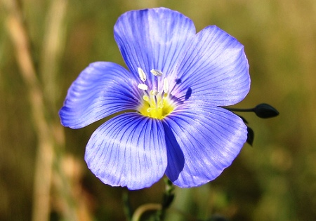
Notes:
atasikā-kusuma — of the linseed flower; avabhāsau — like the luster;
Flaxseed, linseed = same
bhāsā — effulgence, cause by reflection
avabhāsau — like the luster of;
Woman - Lip stick
Light skin, sun tan

Slide 10
Synonyms:
vyālambi — extending down; pīta — yellow; vara — exquisite; vāsasi — on the cloth; vartamāna — being; kāñcī-kalāpa — by a girdle; parirambhi — encircled; nitamba-bimbam — His rounded hips.
Notes:
vyālambi — extending down;
hanging down, draping downward
pīta — yellow;
vara — exquisite; vāsasi — on the cloth;
Vara-puja - vivaha ceremony
Excellent, best, first class
Man/woman
Dress = ordinary cloth
but on them = vara vāsasi
vartamāna — being;
Causes cloth to look exquisitely beautiful
When decorate deity we become beautiful
Decorate face – cannot see
But mirror – see reflection
kāñcī-kalāpa — by a girdle;
kāñcī = girdle, belt
kalāpa = collection of something (i.e. ornaments) ornaments like belt on waist, like bells, lace or folded clothe
parirambhi — encircled;
Ambhi = push, initiate
Pari = go around
nitamba-bimbam — His rounded hips
nitamba = round hips
bimbam = His form

Slide 11
Synonyms:
ojaḥ-nidhī — the storehouse of all energy;
Notes:
ojo-nidhī
ojaḥ = power, potency, energy
nidhī = ocean, storehouse
Pūtanā,
killer many children
found Kṛṣṇa lying small bed
at once perceive baby hiding unparalleled potencies
fire covered ashes.
Pūtanā thought,

Slide 12
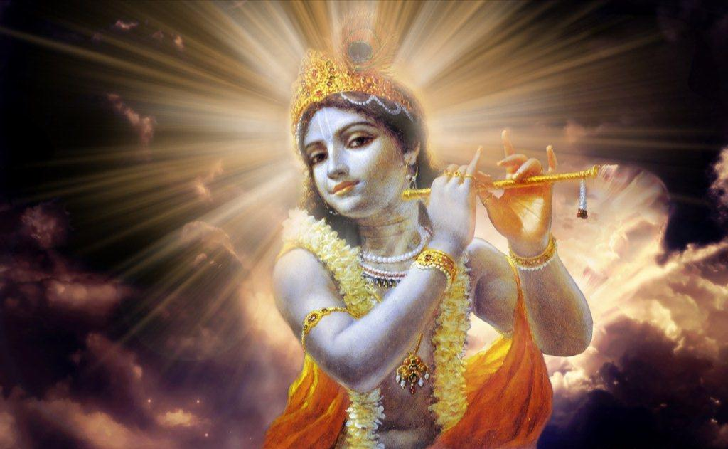
The Lord and His Energies
I shall try to describe the transcendental pastimes of the Lord as far as my knowledge is concerned. As the birds fly in the sky as far as their capacity allows, so devotees describe the Lord as far as their realization allows. (SB 1.18.23)
Notes:
Nothing beyond Lord and His energies
Unlimited, beyond comprehension, ever expanding
Lord Ananta (Balarama)
eternally describing with unlimited mouths
Never come to the end
Therefore: Not possible to describe
But, as far as I understand…
Drop in unlimited ocean
Suta to sages…
Birds fly, though expanse sky have no limit

Slide 13
The Lord and His Energies
cit-çakti
parä-çakti
svarüpa-çakti
I shall try to describe the transcendental pastimes of the Lord as far as my knowledge is concerned. As the birds fly in the sky as far as their capacity allows, so devotees describe the Lord as far as their realization allows. (SB 1.18.23)
Notes:
Names for same primeval energy
Express to beloved
Best
Greatest
No one who can compare with you!

Slide 14
Lord’s Energies
Vivarta-vāda
    Advaita (non-dualism)
Notes:
Mayavada deny energy -
Vivartavada
transformation - alteration, modification, change of form, altered condition or state
Water (liquid) = becomes ice (solid) / steam (gas)
Advaita -non-dualism
apparent modification (of real which does not change)
vivarta (change) Brahman = illusion
Limited understanding, not the whole truth
Mistake Lord and energies and illusionary transformation
Mistake Brahman = void
proper example vivarta = identifiy body as self
But mistake Lord and His energies as vivarta
avajananti mam mudha manusim tanum asritam
avajananti—deride; mam—Me; mudhah—foolish men; manusim—in a human form; tanum—body; asritam—assuming;

Slide 15
Lord’s Energies
Pariṇāma-vāda
    Viśiṣṭādvaita (qualified non-dualism)
Notes:
Pariṇāma-vāda (cause continually transforming itself into its effects)
Viśiṣṭādvaita ; Ramanuja
Viśiṣṭa = end (conclusion) of Vedas.
Advaita, Brahman is unique (one without a second); but possesses qualities
qualified oneness = Brahman alone exists, but characterized by multiplicity
Upanisads, Vedānta-sutra,
“Only Nārāyaṇa existed before the creation.”
Smritis
eko nārāyaṇa āsīt
Only before creation
Maha-Narayana Upanisad
eko vai narayana asin
certainly
Atharva-veda
eko ha vai nārāyaṇa āsīt
Only he
ahaṁ sarvasya prabhavaḥ [Bg. 10.8], “I am the original cause of everything,” and mattaḥ sarvaṁ pravartate, “From Me everything comes into existence.
aham evāsam evāgre
nānyad yat sad-asat param
paścād ahaṁ yad etac ca
yo ’vaśiṣyeta so ’smy aham
aham — I, the Personality of Godhead; eva — certainly; āsam — existed; eva — only; agre — before the creation; na — never; anyat — anything else; yat — all those; sat — the effect; asat — the cause; param — the supreme; paścāt — at the end; aham — I, the Personality of Godhead; yat — all these; etat — creation; ca — also; yaḥ — everything; avaśiṣyeta — remains; saḥ — that; asmi — I am; aham — I, the Personality of Godhead.
It is I, who was existing before creation, when there nothing but Myself.
Nor was there pradhāna (the cause mahattva)
That which see now is also I
after annihilation what remains also I

Slide 16
Lord’s Energies
Śakti Pariṇāma-vāda
Notes:
Śakti Pariṇāma-vāda (Caitanya Mahāprabhu) = acintyabhedābheda

Slide 17
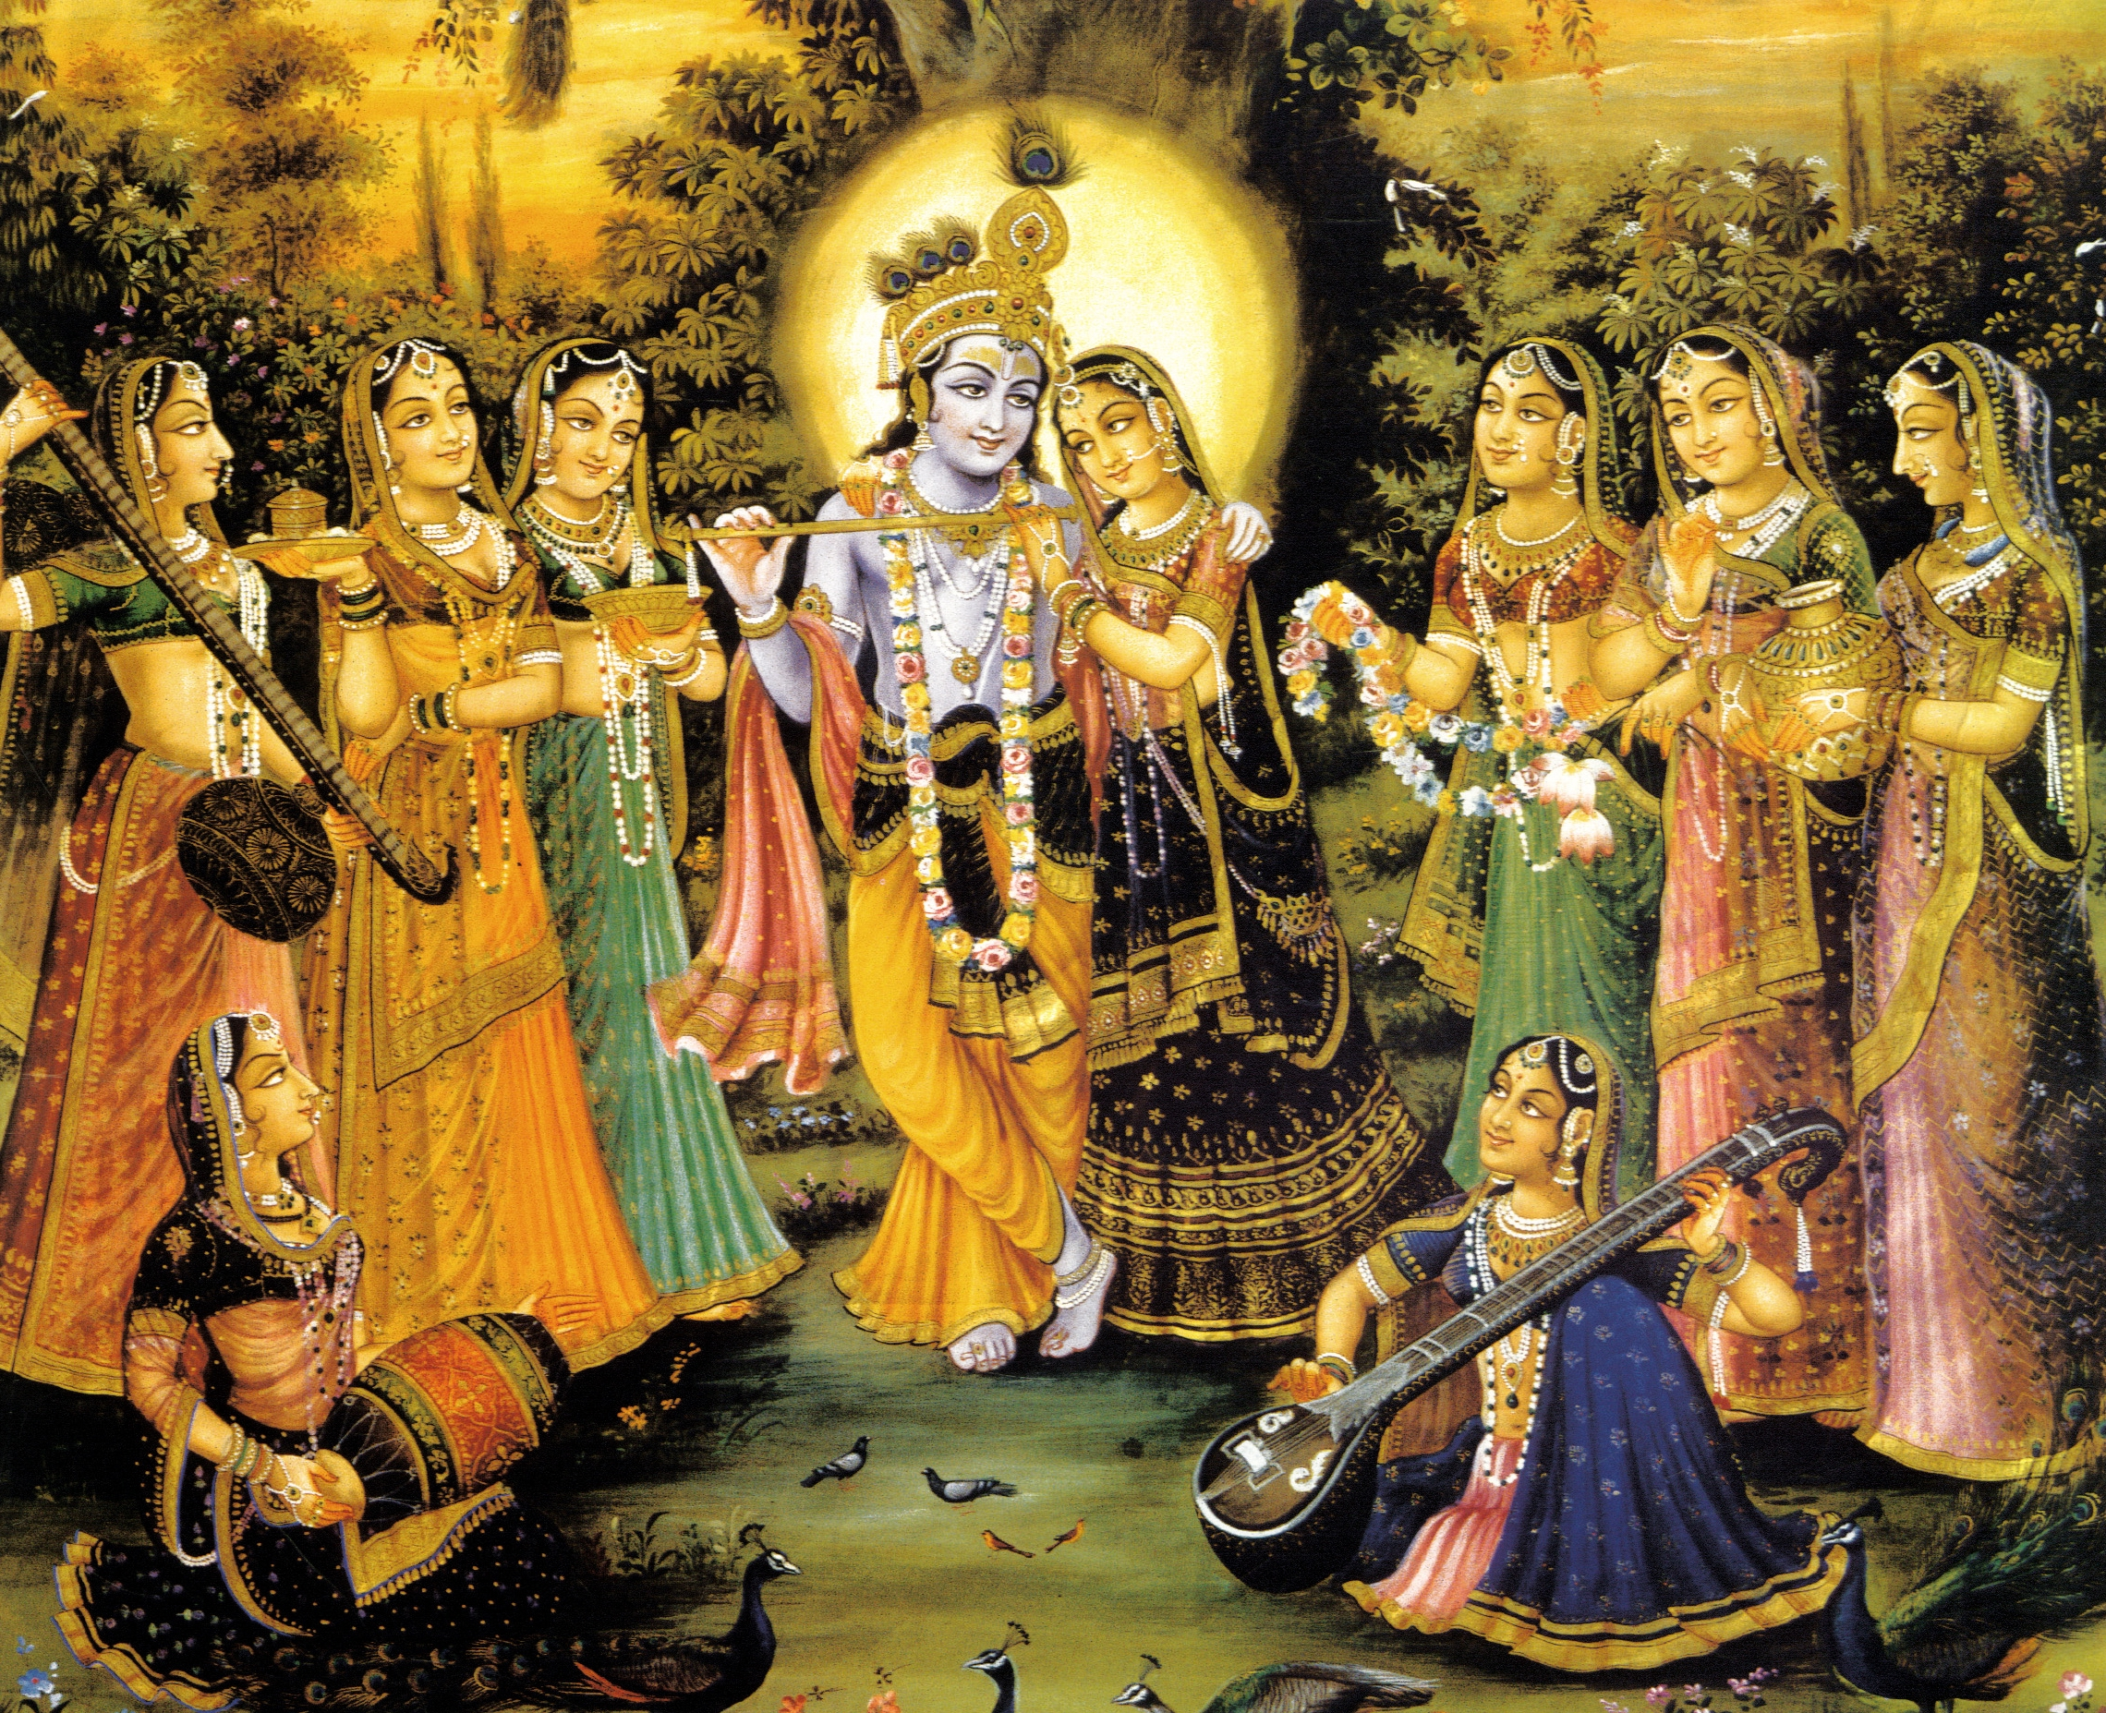
Notes:
Chandogya Upanishad 6.2.1
agra asid ekam (in beginning was one Supreme)
evadvitiyam (who was one without a second)
tad aikshata (He thought)
bahu syam prajayeya (Let me become many. Let me become the father of many)
Taittiriya Upanishad (2.6.1)
so 'kamayata bahu syam prajayeya
He desired: I will become many. I will father many children
Vedanta-sutra
eko bahu syam (one became many)
Bs 5.37
ānanda-cinmaya-rasa-pratibhāvitābhis
tābhir ya eva nija-rūpatayā kalābhiḥ
goloka eva nivasaty akhilātma-bhūto
govindam ādi-puruṣaṁ tam ahaṁ bhajāmi
Synonyms:
ānanda — bliss; cit — and knowledge; maya — consisting of; rasa — mellows;
prati — every second; bhāvitābhiḥ — who are engrossed with; tābhiḥ — with those;
yaḥ — who; eva — certainly; nija-rūpatayā — with His own form; kalābhiḥ — who are parts of portions of His pleasure potency;
goloke — in Goloka Vṛndāvana; eva— certainly; nivasati — resides; akhila-ātma — as the soul of all; bhūtaḥ — who exists;
Translation:
I worship Govinda, the primeval Lord, residing in His own realm, Goloka, with Rādhā, resembling His own spiritual figure, the embodiment of the ecstatic potency possessed of the sixty-four artistic activities, in the company of Her confidantes [sakhīs], embodiments of the extensions of Her bodily form, permeated and vitalized by His ever-blissful spiritual rasa.

Slide 18
svarüpa-çakti
parä-çakti: internal spiritual potency
Notes:
na tasya kāryaṁ karaṇaṁ ca vidyate
na tat-samaś cābhyadhikaś ca dṛśyate
parāsya śaktir vividhaiva śrūyate
svābhāvikī jñāna-bala-kriyā ca
nothing He has to do
Therefore we see no one equal or greater
for everything done naturally and systematically by multifarious energies,
providing Him full knowledge, power and pastimes
(Śvetāśvatara Upaniṣad 6.8)

Slide 19
svarüpa-çakti defined
sandhiné
saàvit
hlädiné
bala: strength and opulence
Sambandha
(relationship)
jïäna: knowledge
Abhidheya
(means to achieve goal)
kriyä: loving exchanges
Prayojana
(ultimate goal)
Notes:
See MS Word cit shakti.docx

Slide 20
Interactions of svarüpa-çakti
Notes:
How interact each other
What happens when energies come in contact with each other

Slide 21
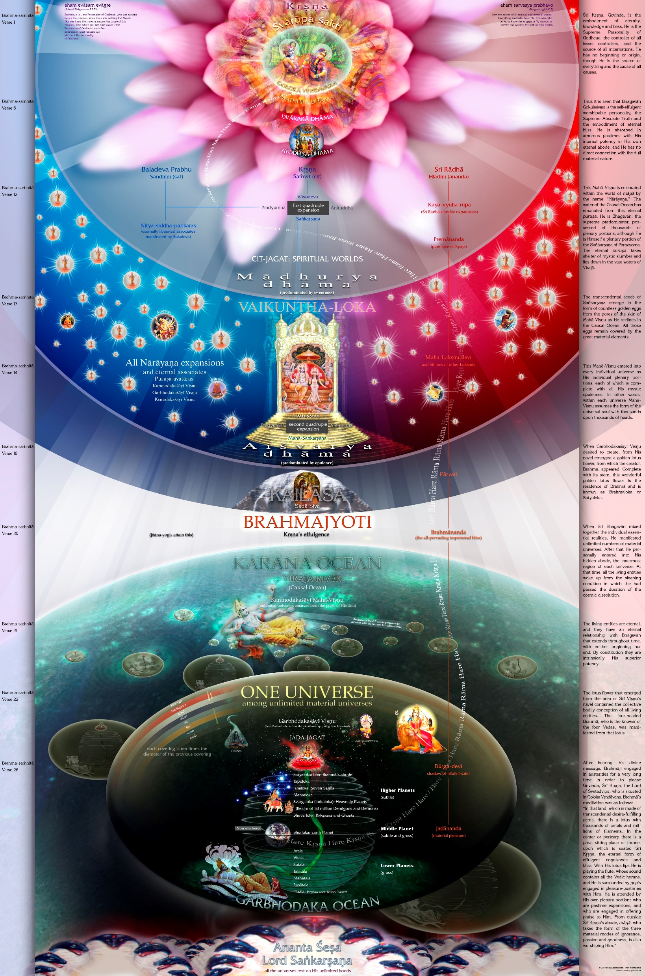
Notes:
Atheists
Imperfect world
Christians
Enjoyer, smile in garden
Islam
Kill if depict
Buddhist
Zero
Mayavada
Brahman, white light
Brahma-vaivarta Purana
Narada:
Why Krishna come to earth?
who asked?
Narayana Rsi said:
during Varaha-kalpa, earth took shelter Brahma.
Brahma, Siva, Yamaraja, etc.
went Lord Hari’s abode,...
10 million yojanas above Brahmaloka,
go to Goloka
500 million yojanas above Vaikuntha
78 The demigods were eager to go to that place beyond description. Travelling at the speed of mind, they all went to the shore of the Viraja river.
79 The demigods became filled with wonder when they saw that beautiful and broad riverbank splendid with pure crystal,...
80 ...glittering with pearls, rubies, parasa jewels, and many kinds of blue, white, green and red jewels,...
81 ...somewhere beautiful with coral grass and decorated with priceless transcendental gems,...
82 ...somewhere filled with treasuries of rubies and sapphires Brahma had never seen before,...
83 somewhere filled with treasuries of emeralds, somewhere syamantaka jewels, and somewhere rucaka jewels,...
84 ...somewhere filled with treasuries of topaz, somewhere kaustubha jewels, and somewhere other jewels,...
85 ...somewhere filled with treasuries of jewels that are beyond description, and somewhere filled with beautiful and delightful pastime places.
86 After gazing at this place, the (three) demigods crossed to the farther shore, where they saw a beautiful mountain with a hundred peaks,...
87 ...splendid with parijata trees, filled with kalpa-vrksa trees and surabhi cows,...
88 ...ten million yojanas high, ten times as long, and five hundred millions yojanas wide,...
89 ...on its peak a beautiful walled rasa-dance circle ten yojanas across,...
90 ...with a thousand gardens of fragrant blossoming flowers attended by swarms of black bees,...
91 ...splendid with jewelled pastime palaces and with a thousand multiplied by ten million jewel pavilions,...
92-93 ...splendid with jewel staircases, beautiful jewel domes, and a splendid emerald pillar studded with rubies and its middle decorated with beautiful sapphires,...
94 ...splendid with jewel walls and four gates of many jewels,...
95 ...with many mango trees tied with diamonds, and with many banana trees,...
96 ...with the leaves of white-rice plants, with fruits, and with durva grass, anointed with sandal, aguru, musk and kunkuma,...
97 ...filled, O sage with many millions of youthful gopis decorated with jewel ornaments, splendid with jewel necklaces,...
98 ...decorated with jewel bracelets, armlets, and anklets, their cheeks splendid with jewel earrings,...
99 ...their fingers beautifully decorated with jewel rings, their toes splendid with a network of jewels,...
100 ...decorated with jewel ornaments, splendid with jewel crowns, their nostrils splendidly decorated with a gajendra-pearl ornament,...
101 ...the place below their curly hair splendid with a dot of red sindura, their complexions the colour of beautiful campaka flowers, (their limbs) anointed with sandal paste,...
102 ...dressed in yellow garments, their beautiful lips bimba fruits, the splendour of their faces eclipsing the autumn moonlight,...
103 ...their eyes eclipsing the beauty of lotuses blooming in autumn, their eyes glistening with black kajjala and designs drawn in musk,...
104 ...their braids decorated with malata blossoms that attract black bees greedy for nectar,...
105 ...their graceful motions defeating the elephants and khanjana birds, the crooked motions of their curved eyebrows suggesting a slight smile,...
106 ...splendid with teeth like ripe pomegranate seeds, decorated with raised noses opulent like the king of birds’ beak,...
107 ...their heavy breasts like the elephant king’s cheeks, their thighs firm and their hips broad,...
108 ...their hearts wounded by Kama’s arrows, passionately yearning to gaze on the full moon of (Lord Krishna’s) face...
109 ...(their forms) beautiful, attached to serving Shri Radha’s lotus feet, and by Radha’s order engaged in protecting that place,...
110 ...which was always filled with a hundred thousand pastime lakes filled with red and white lohita lotuses, splendid padma lotuses, sweetly humming black bees,...
111 ...and which had a thousand gardens of blossoming flowers and many forest cottages with couches of flowers,...
112 ...betel nuts and camphor, jewel lamps, white camaras,...
113 ...and wonderful, beautiful, and colourful flower garlands. O sage, after seeing this rasa dance circle, the (three) demigods left that mountain.
114 Then they saw Radha-Krishna’s favourite forest, which was named Vrndavana forest, which was extraordinarily beautiful and charming,...
115 ...which was a place where Radha and Krishna enjoyed pastimes, which was filled with kalpa-vrksa trees and gentle breezes carrying drops of water from the shore of the Viraja river,...
116 ...which was fragrant with musk designs everywhere, filled with new sprouts and with the cooing of cuckoos,...
117 ...beautiful with somewhere keli-kadamba trees, somewhere mandara trees, somewhere sandal trees, and somewhere campaka trees,...
118 ...scented with fragrant flowers of mango, nagaranga and panasa trees,...
119 ...filled with forests of tala, coconut, jambu, badari, kharjura,...
120 ...guvakamrataka, jambira, banana, shriphala, and pomegranate trees, O Narada,...
121 ...splendid with many piyala, sala, and banyan trees, with many trees bearing ripe tala fruits,...
122 ...with many beautiful nimba, salmali, tintidi, and with other kinds of trees,...
123 ...splendid with many kalpa-vrksa trees everywhere, with mallika, malati, kunda, ketaki, and madhavi vines,...
124 ...with many yuthika flowers, with five hundred million forest cottages, O sage,...
125 ...with jewel lamps, with decorations fragrant with incense, with fragrant breezes,...
126 ...and with beds made of flowers decorated with a network of flower garlands and scented with sandal filled with sweet sounds of bees greedy for nectar,...
127 ...filled with gopis beautifully decorated with jewel ornaments, by Radha’s order protected by five hundred million gopis,...
128 ...filled with thirty-two forests of which beautiful, beautiful, beautiful, secluded Vrndavana is the best,...
129 ...filled, O sage, with many perfectly ripe, sweet, delicious fruits, filled with many cows and barns,...
130 ...filled with a thousand fragrant gardens of blossoming flowers (attracting) hosts of bees greedy for nectar,...
131 ...and splendid with the jewel homes of five hundred million gopas whose forms were like Shri Krishna’s.
132 After gazing at beautiful Vrndavana, the (three) demigods went to circular Goloka, which was ten million yojanas in size,...
133 ...which was surrounded by a jewel wall with four gates protected by many gopa gatekeepers,...
134 ...and which had five hundred million asramas of Lord Krishna’s servants, asramas studded with jewels and filled with many delightful things,...
135 ...one billion asramas of Lord Krishna’s devotees, asramas even more beautifully made of many jewels,...
136 ...one hundred million asramas of Lord Krishna’s associates, asramas even more beautifully made of precious jewels,...
137 ...ten million jewel asramas of the Lord’s intimate associates, whose forms were like Lord Krishna’s,...
138 ...320 million jewel asramas of gopis purely devoted to Shri Radha,...
139 ...one hundred million beautiful jewel asramas of these gopis’ maidservants,...
140-44 ...and one billion beautiful asramas of they who, purified by austerities in a hundred births, became very firm devotees on earth in Bharata-varsa, awake or asleep rapt in meditation on Lord Hari, and chanting “Radha-Krishna! Krishna!” day and night, asramas made of many jewels, filled with many delightful things, splendid with flower couches, flower garlands, white camaras, jewel mirrors, many sapphires, curtains of fine cloth, and roofs decorated with many domes made of priceless jewels.
145 After gazing at this wonderful place, the (three) demigods went a little further and happily saw a beautiful and eternal banyan tree,...
146 ...five yojanas across and twice as many high, with a thousand trunks and countless branches,...
147 ...and beautiful with jewel platforms and many ripe jewel fruits. At the root of that tree the demigods saw many cowherd boys who had forms like Lord Krishna,...
148 ...and who were dressed in yellow garments, attached to playing, handsome, decorated with jewel ornaments, and all of whose limbs were anointed with sandal paste.
149 The demigods gazed at these close associates of Lord Hari and then looked far away at the beautiful royal path,...
150 ..which was paved with sapphires, rubies, diamonds, rucaka jewels, and jewels the colour of red sindura,...
151 ...which had many benches and jewel pavilions, which was anointed with sandal, aguru, musk, and kunkuma,...
152-3 ...which was splendid with many banana trees decorated with yoghurt drops, leaves, rice, fruit, flowers, sandal anointed flowers strung on fine threads, kunkuma, auspicious jewel bells, and branches filled with fruit,...
154 ...decorated with flower garlands anointed with sindura, kunkuma, and fragrant sandal,...
155 ...and filled with many playful gopis.
156-8 Then, seeing in the distance a beautiful place surrounded by a moat and jewel walls with sixteen gates guarded by gatekeepers, splendid with jewel stairways, beautiful curtains more pure than fire, mirrors, white camaras, wonderful jewel beds, and flower garlands and anointed with sandal, aguru, musk, and kunkuma, the demigods became very eager to proceed.
159 O Narada, after going a short distance they saw the beautiful asrama of Radha, who is the queen of the rasa dance,...
160 ...the queen of the demigods, the best of the gopis, and She who to Lord Krishna is more dear than life, a beautiful, beautiful asrama,...
161 ..that was completely indescribable, that no great pandita could describe, that was a great circle of six gavyutis,...
Note: A gavyuti is equal to two miles.
162 ...that had a hundred palaces, shone with the splendour of many jewels, was made of the best of the best of priceless jewels,...
163 ...was beautiful with many impassable deep moats, filled with a hundred flower gardens and many kalpa-vrksa trees, constructed with many jewels, surrounded by great walls,...
164 ...and was made with jewel benches and seven wonderful jewel gates, O sage,...
165 ...and a series of seven gates that led, one after the other, to a place of sixteen gates.
166 Gazing at this great wall as tall as a thousand bows and splendidly beautiful with many small jewel domes, the (three) demigods became filled with wonder.
167 Keeping it on their right, they happily went a small distance behind that asrama.
168 There they saw a billion asramas of many gopas and gopis.
169 They gazed again and again at the beautiful, beautiful ever new asramas of the gopas and gopis.
170 After thus seeing all of Goloka, the demigods returned to the beautiful circle of Vrndavana forest.
171 The demigods saw the mountain of a hundred peaks and went past it to the Viraja river. When they went past the Viraja river they saw nothing more.
172-3 Thus the demigods gazed at auspicious, wonderful, spiritual Goloka, which had a thousand lakes, which was made of jewels, and which, by the will of Lord Krishna and the wisdom of Shri Radha, was situated in the spiritual sky. The demigods then gazed at the beautiful dancing they saw there.
174 Then. O sage, as they heard beautiful, beautifully rhythmic, nectar songs there about the glories of Shri Shri Radha-Krishna, the demigods fainted.
175 Regaining consciousness in a moment, and their thoughts now fixed on Lord Krishna, the demigods gazed at the many beauties and wonders there in place after place.
176 They saw all the beautiful gopis dressed in many different kinds of garments, some with mrdangas in their hands, some with vinas in their hands,...
177 ...some with camaras in their hands, some with karatalas in their hands, some with various musical instruments in their hands, some making their jewel anklets tinkle melodiously,...
178 ...some making a whole network of jewel ornaments tinkle, some spontaneously dancing as they carried jugs on their heads,...
179 ...some dressed as men with others dressed as their heroines, some dressed as Krishna with others dressed as Radha,...
180 ...some in the mood of separation, and others happily embracing each other. As they gazed at these playful gopis, the (three) demigods smiled.
181 O Narada, going a little further, they saw the asramas of Radha’s friends, and then the homes of Her dearest friends,...
182 ...who in beauty, virtues, dress, appearance, youthful spirit, good fortune, and age were just like Her.
183 Now please hear the names of Shri Radha’s thirty-three gopi friends, who are beyond description.
184 They are Susila, Sasikala, Yamuna, Madhavi, Rati, Kadambamala, Kunti, Jahnavi, Svayamprabha,...
185 ...Candramukhi, Padmamukhi, Savitri, Sudhamukhi, Subha, Padma, Parijata, Gauri, Sarvamangala,...
186 ...Kalika, Kamala, Durga, Bharati, Sarasvati, Gangambika, Madhumati, Campaparna, Sundari,...
187 ...Krishnapriya, Sati, Nandani, and Nandana, their forms were like Shri Radha’s. Their asramas were made of jewels,...
188 ...decorated with many wonders, beautiful, splendid with many domes of priceless jewels,...
189 ...splendid, and made with the best of jewels. This world is beyond the material world. There is no world higher than this.
190 Above this there is nothing. What exists culminates in this world. In the same way, there is nothing below the seven realms of Rasatala.
191 Below them is only impassable and invisible water and darkness. Now you have heard from me all about the boundaries of the universe and what lies beyond the universe.

