Slide 1

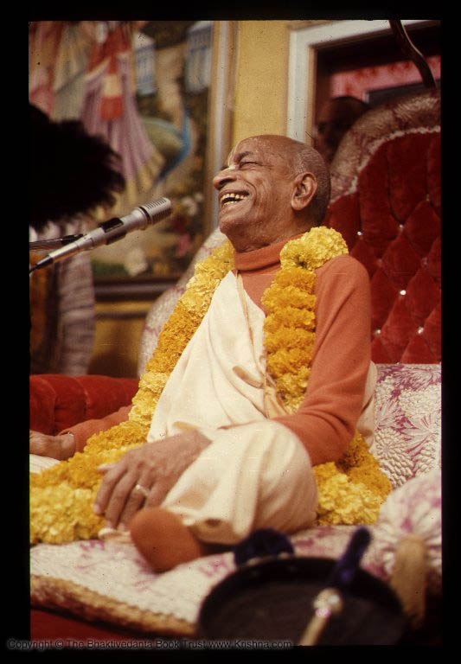
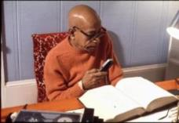
Srimad Bhagavatam 3.15.25
ISKCON Hawaii
Thursday, 2016 Septemnber 15
Hanumat-presaka Swami
ISKCON Founder-Acharya
Srila A. C. Bhaktivedanta Swami Prabhupada

Slide 2


3.15.25
yac ca vrajanty animiṣām ṛṣabhānuvṛttyā
dūre yamā hy upari naḥ spṛhaṇīya-śīlāḥ
bhartur mithaḥ suyaśasaḥ kathanānurāga
vaiklavya-bāṣpa-kalayā pulakī-kṛtāńgāḥ

Slide 3
yat — Vaikuṇṭha;
ca — and;
vrajanti — go;
animiṣām — of the demigods;
ṛṣabha — chief;
anuvṛttyā — following in the footsteps;
dūre— keeping at a distance;
yamāḥ — regulative principles;
hi — certainly;
upari — above;
naḥ — us;
spṛhaṇīya — to be desired;
śīlāḥ — good qualities;
bhartuḥ — of the Supreme Lord;
mithaḥ — for one another;
suyaśasaḥ — glories;
kathana — by discussions, discourses;
anurāga — attraction;
vaiklavya — ecstasy;
bāṣpa-kalayā — tears in the eyes;
pulakī-kṛta — shivering;
ańgāḥ — bodies

Slide 4

Persons:
  Whose bodily features change in ecstasy
  And who breathe heavily
  And perspire
Due to hearing the glories of the Lord
Are promoted to the kingdom of God,
Even though they do not care for meditation and other austerities.
The kingdom of God is
Above the material universes,
And it is desired by Brahmā and other demigods.

Slide 5
Even though they do not care for meditation and other austerities.
Due to hearing the glories of the Lord
Persons:
  Whose bodily features change in ecstasy
  And who breathe heavily
  And perspire
Are promoted to the kingdom of God which is,
  Above the material universes,
  And it is desired by Brahmā and other demigods.

Slide 6
It is clearly stated herein that the kingdom of God is above the material universes. Just as there are many hundreds of thousands of higher planets above this earth, so there are many millions and billions of spiritual planets belonging to the spiritual sky. Brahmājī states herein that the spiritual kingdom is above the kingdom of the demigods.

Slide 7
One can enter the kingdom of the Supreme Lord only when one is highly developed in desirable qualities.
All good qualities develop in the person of a devotee. It is stated in Śrīmad-Bhāgavatam, 5.18.12, that anyone who is Kṛṣṇa conscious is endowed with all the good qualities of the demigods. In the material world the qualities of the demigods are highly appreciated, just as, even in our experience, the qualities of a gentleman are more highly appreciated than the qualities of a man in ignorance or in a lower condition of life.
The qualities of the demigods in the higher planets are far superior to the qualities of the inhabitants of this earth.

Slide 8
he accepts Kṛṣṇa consciousness as the highest goal of life; he is equal to everyone; no one can find fault in his character; he is magnanimous, mild and always clean, internally and externally; he does not profess to possess anything in this material world; he is a benefactor to all living entities; he is peaceful and is a soul completely surrendered to Kṛṣṇa;
Brahmājī confirms herewith that only persons who have developed the desirable qualities can enter into the kingdom of God. In the Caitanya-caritāmṛta, the devotee's desirable qualities are described to be twenty-six in number. They are stated as follows:
He is very kind;
he does not quarrel with anyone;
he accepts Kṛṣṇa consciousness as the highest goal of life;
he is equal to everyone;
no one can find fault in his character;
he is magnanimous,
mild and
always clean, internally and externally;
he does not profess to possess anything in this material world;
he is a benefactor to all living entities;
he is peaceful

Slide 9
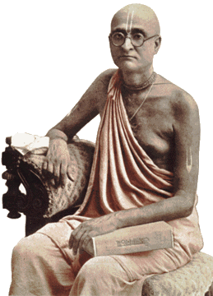
and is a soul completely surrendered to Kṛṣṇa;
he has no material desire to fulfill;
he is meek and
humble,
always steady, and
has conquered the sensual activities;
he does not eat more than required to maintain body and soul together;
he is never mad after material identity;
he is respectful to all others and
does not demand respect for himself;
he is very grave,
very compassionate and
very friendly;
he is poetic;
he is expert in all activities, and
he is silent in nonsense.

Slide 10
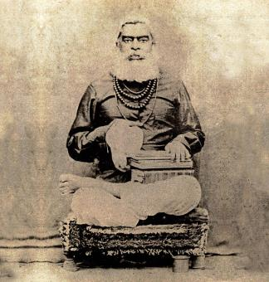
very tolerant and very kind to all living entities. He is not partial; he is kind both to human beings and to animals. He is not such a fool that he will kill a goat Nārāyaṇa to feed a human Nārāyaṇa, or daridra-nārāyaṇa. He is very kind to all living entities;
therefore he has no enemy.
He is very peaceful.
These are the qualities of persons who are eligible to enter into the kingdom of God.
Similarly, in Śrīmad-Bhāgavatam, 3.25.21, the qualifications of a saintly person are mentioned. It is said there that a saintly person eligible to enter into the kingdom of God is

Slide 11
That such a person gradually becomes liberated and enters the kingdom of God is confirmed in Śrīmad-Bhāgavatam, 5.5.2.
The Śrīmad-Bhāgavatam, 2.3.24, also states that if a person does not cry or exhibit bodily changes after chanting the holy name of God without offense, it is to be understood that he is hardhearted and that therefore his heart does not change even after he chants the holy name of God, Hare Kṛṣṇa.
These bodily changes can take place due to ecstasy when we offenselessly chant the holy names of God: Hare Kṛṣṇa, Hare Kṛṣṇa, Kṛṣṇa Kṛṣṇa, Hare Hare/ Hare Rāma, Hare Rāma, Rāma Rāma, Hare Hare.

Slide 12
It may be noted that there are ten offenses we should avoid.
The first offense is to decry persons who try in their lives to broadcast the glories of the Lord. People must be educated in understanding the glories of the Supreme; therefore the devotees who engage in preaching the glories of the Lord are never to be decried. It is the greatest offense.
Furthermore, the holy name of Viṣṇu is the most auspicious name, and His pastimes are also nondifferent from the holy name of the Lord. There are many foolish persons who say that one can chant Hare Kṛṣṇa or chant the name of Kālī or Durgā or Śiva because they are all the same. If one thinks that the holy name of the Supreme Personality of Godhead and the names and activities of the demigods are on the same level, or if one accepts the holy name of Viṣṇu to be a material sound vibration, that is also an offense.

Slide 13
The third offense is to think of the spiritual master who spreads the glories of the Lord as an ordinary human being.
The fourth offense is to consider the Vedic literatures, such as the Purāṇas or other transcendentally revealed scriptures, to be ordinary books of knowledge.
The fifth offense is to think that devotees have given artificial importance to the holy name of God. The actual fact is that the Lord is nondifferent from His name. The highest realization of spiritual value is to chant the holy name of God, as prescribed for the age — Hare Kṛṣṇa, Hare Kṛṣṇa, Kṛṣṇa Kṛṣṇa, Hare Hare/ Hare Rāma, Hare Rāma, Rāma Rāma, Hare Hare.

Slide 14
The sixth offense is to give some interpretation on the holy name of God.
The seventh offense is to act sinfully on the strength of chanting the holy name of God. It is understood that one can be freed from all sinful reaction simply by chanting the holy name of God, but if one thinks that he is therefore at liberty to commit all kinds of sinful acts, that is a symptom of offense.
The eighth offense is to equate the chanting of Hare Kṛṣṇa with other spiritual activities, such as meditation, austerity, penance or sacrifice. They cannot be equated at any level.
The ninth offense is to specifically glorify the importance of the holy name before persons who have no interest.
The tenth offense is to be attached to the misconception of possessing something, or to accept the body as one's self, while executing the process of spiritual cultivation.

Slide 15
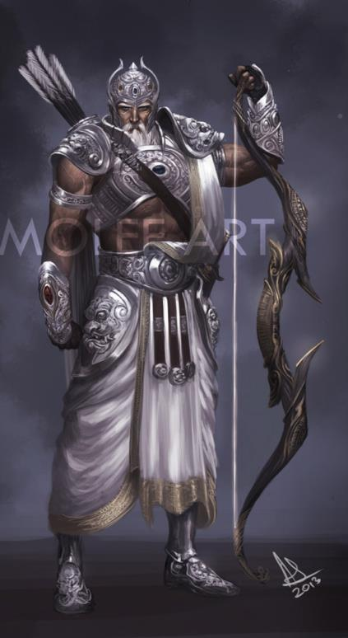
When one is free from all ten of these offenses in chanting the holy name of God, he develops the ecstatic bodily features called pulakāśru. Pulaka means "symptoms of happiness," and aśru means "tears in the eyes.“
The symptoms of happiness and tears in the eyes must appear in a person who has chanted the holy name offenselessly.
Here in this verse it is stated that those who have actually developed the symptoms of happiness and tears in the eyes by chanting the glories of the Lord are eligible to enter the kingdom of God.

Slide 16

In the Caitanya-caritāmṛta it is said that if one does not develop these symptoms while chanting Hare Kṛṣṇa, it is to be understood that he is still offensive.
Caitanya-caritāmṛta suggests a nice remedy in this connection. There it is said in verse 31, Chapter Eight, of Ādi-līlā, that if anyone takes shelter of Lord Caitanya and just chants the holy name of the Lord, Hare Kṛṣṇa, he becomes freed from all offenses.

Slide 17
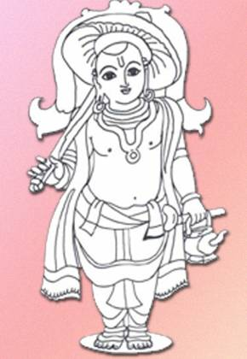
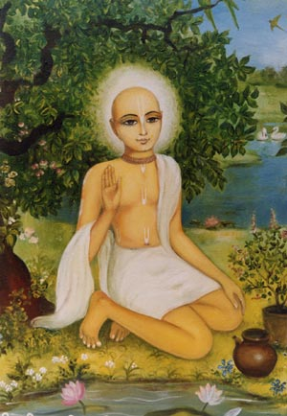




Slide 18
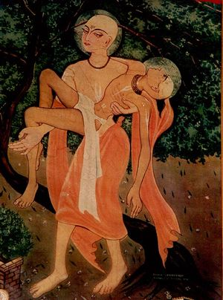
Antya-lila, Chapter 11
The Passing of Haridāsa Ṭhākura

Slide 19
CC Antya 11.50-56: In front of all the great devotees like Rāmānanda Rāya and Sārvabhauma Bhaṭṭācārya, Śrī Caitanya Mahāprabhu began to describe the holy attributes of Haridāsa Ṭhākura.
As He described the transcendental attributes of Haridāsa Ṭhākura, Śrī Caitanya Mahāprabhu seemed to possess five mouths. The more He described, the more His great happiness increased.
After hearing of the transcendental qualities of Haridāsa Ṭhākura, all the devotees present were struck with wonder. They all offered their respectful obeisances to the lotus feet of Haridāsa Ṭhākura.

Slide 20
Haridāsa Ṭhākura made Śrī Caitanya Mahāprabhu sit down in front of him, and then he fixed his eyes, like two bumblebees, on the lotus face of the Lord.
He held the lotus feet of Śrī Caitanya Mahāprabhu on his heart and then took the dust of the feet of all the devotees present and put it on his head.
He began to chant the holy name of Śrī Kṛṣṇa Caitanya again and again. As he drank the sweetness of the face of the Lord, tears constantly glided down from his eyes.
While chanting the holy name of Śrī Kṛṣṇa Caitanya, he gave up his air of life and left his body.

Slide 21

Śrī Caitanya Caritāmṛta Antya 11.99
sabe gāya, — "jaya jaya jaya haridāsa
nāmera mahimā yeńha karilā prakāśa"
Visvarupa
mahotsava
Srila Prabhupada Sannyasa
Anniversary of NoI

Slide 22

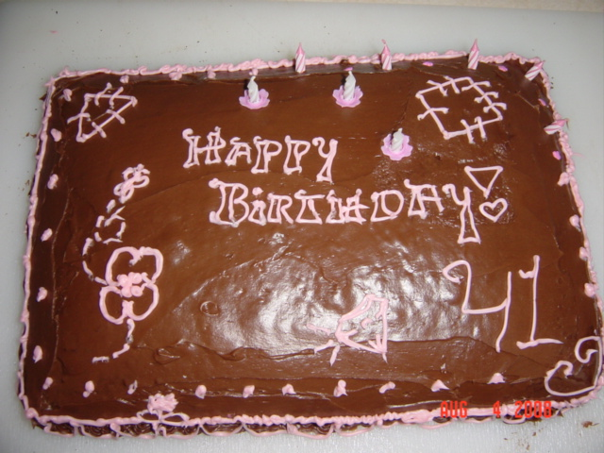
September 20, 1975
Raman-reti
Vrndavana, India
41

Slide 23
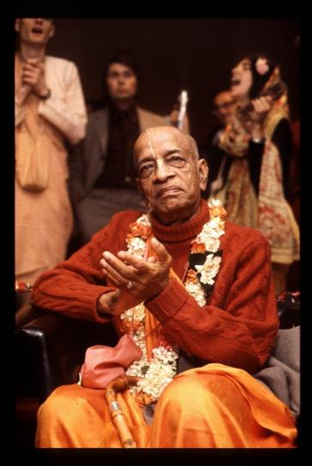

Thank you
AGTSP
www.JayaRama.us

