Slide 1

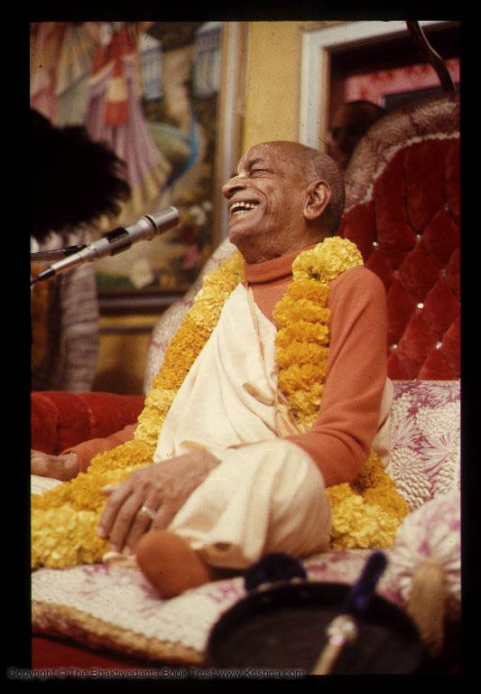

Srimad Bhagavatam 3.15.20
ISKCON Hawaii
Thursday, 2016 Septemnber 8
Hanumat-presaka Swami
ISKCON Founder-Acharya
Srila A. C. Bhaktivedanta Swami Prabhupada

Slide 2


SB 3.15.20
yat saṅkulaṁ hari-padānati-mātra-dṛṣṭair
vaidūrya-mārakata-hema-mayair vimānaiḥ
yeṣāṁ bṛhat-kaṭi-taṭāḥ smita-śobhi-mukhyaḥ
kṛṣṇātmanāṁ na raja ādadhur utsmayādyaiḥ

Slide 3
yat — that Vaikuṇṭha abode;
saṅkulam — is pervaded;
hari-pada — at the two lotus feet of Hari, the Supreme Personality of Godhead;
ānati — by obeisances;
mātra — simply;
dṛṣṭaiḥ — are obtained;
vaidūrya — lapis lazuli;
mārakata — emeralds;
hema — gold;
mayaiḥ — made of;
vimānaiḥ — with airplanes;

Slide 4
yeṣām— of those passengers;
bṛhat — large;
kaṭi-taṭāḥ — hips;
smita — smiling;
śobhi — beautiful;
mukhyaḥ — faces;
kṛṣṇa — in Kṛṣṇa;
ātmanām — whose minds are absorbed;
na — not;
rajaḥ — sex desire;
ādadhuḥ — stimulate;
utsmaya-ādyaiḥ — by intimate friendly dealings, laughing and joking.

Slide 5

Translation:
The inhabitants of Vaikuṇṭha travel in their airplanes made of lapis lazuli, emerald and gold. Although crowded by their consorts, who have large hips and beautiful smiling faces, they cannot be stimulated to passion by their mirth and beautiful charms.

Slide 6
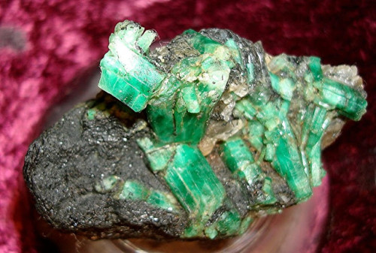
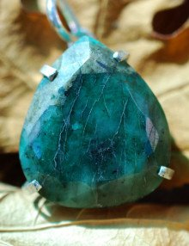
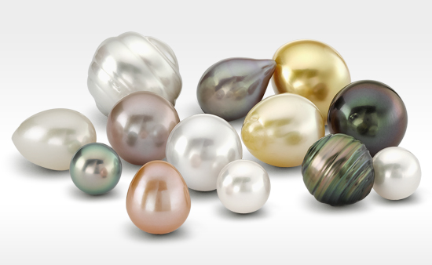
Purport:
In the material world, opulences are achieved by materialistic persons by dint of their labor. One cannot enjoy material prosperity unless he works very hard to achieve it.
But the devotees of the Lord who are residents of Vaikuṇṭha have the opportunity to enjoy a transcendental situation of jewels and emeralds.

Slide 7

Ornaments made of gold bedecked with jewels are achieved not by working hard but by the benediction of the Lord. In other words, devotees in the Vaikuṇṭha world, or even in this material world, cannot be poverty-stricken, as is sometimes supposed.
They have ample opulences for enjoyment, but they need not labor to achieve them.

Slide 8



It is also stated that in the Vaikuṇṭha world the consorts of the residents are many, many times more beautiful than we can find in this material world, even in the higher planets.
It is specifically mentioned here that a woman’s large hips are very attractive and they stimulate man’s passion,
but the wonderful feature of Vaikuṇṭha is that although the women have large hips and beautiful faces and are decorated with ornaments of emeralds and jewels, the men are so absorbed in Kṛṣṇa consciousness that the beautiful bodies of the women cannot attract them.

Slide 9
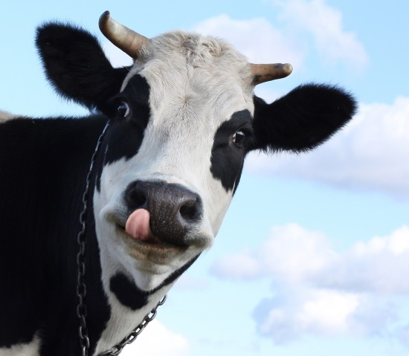
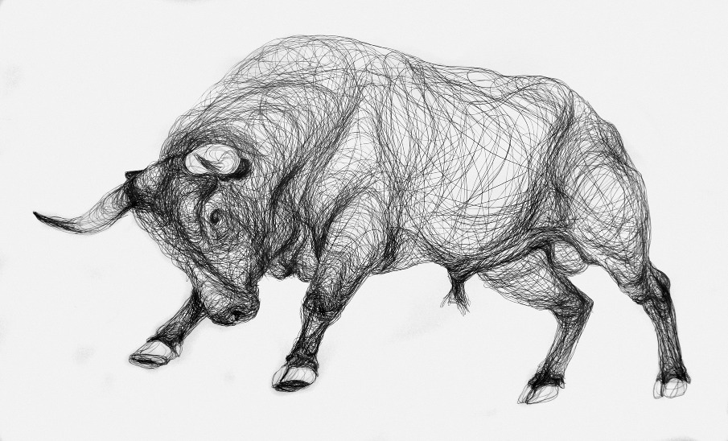
Bulls & Cows

Slide 10

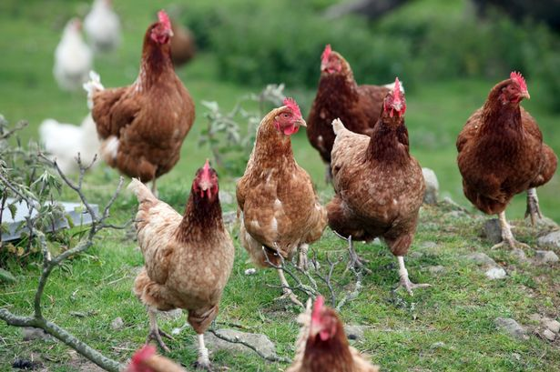
Cocks & Hens

Slide 11
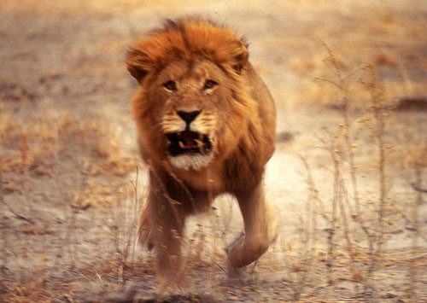
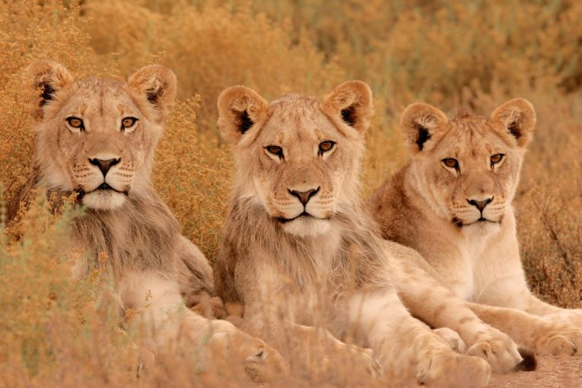
Lion
Lioness

Slide 12


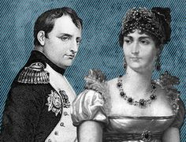

Slide 13
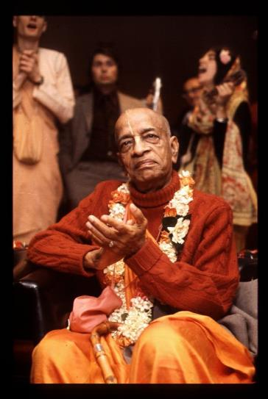

Thank you
AGTSP
www.JayaRama.us

