Slide 1


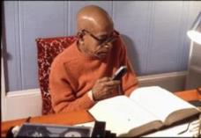
Srimad Bhagavatam 3.13.9
ISKCON Hawaii
Thursday, 2016 June 2
Hanumat-presaka Swami
ISKCON Founder-Acharya
Srila A. C. Bhaktivedanta Swami Prabhupada

Slide 2


3.13.9
brahmovāca
prītas tubhyam ahaḿ tāta
svasti stād vāḿ kṣitīśvara
yan nirvyalīkena hṛdā
śādhi mety ātmanārpitam

Slide 3

brahmā uvāca — Brahmā said;
prītaḥ — pleased;
tubhyam — unto you;
aham — I;
tāta — my dear son;
svasti — all blessings;
stāt — let there be;
vām — unto you both;
kṣiti-īśvara — O lord of the world
yat — because;
nirvyalīkena — without reservation;
hṛdā — by the heart;
śādhi — give instruction;
mā — unto me;
iti — thus;
ātmanā — by self;
arpitam — surrendered.

Slide 4


TRANSLATION
Lord Brahmā said: My dear son, O lord of the world, I am very pleased with you, and I desire all blessings for both you and your wife. You have without reservation surrendered yourself unto me with your heart for my instructions.

Slide 5

PURPORT
The relationship between the father and the son is always sublime.
The father is naturally disposed with good will towards the son, and he is always ready to help the son in his progress in life.
But in spite of the father's good will, the son is sometimes misguided because of his misuse of personal independence.
Every living entity, however small or big he may be, has the choice of independence.

Slide 6
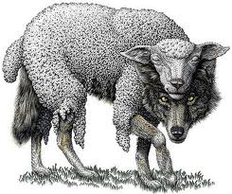
If the son is unreservedly willing to be guided by the father, the father is ten times more eager to instruct and guide him by all means.
The father and son relationship as exhibited here in the dealings of Brahmā and Manu is excellent.
Both the father and the son are well qualified, and their example should be followed by all humankind.

Slide 7
Manu, the son, unreservedly asked the father, Brahmā, to instruct him, and the father, who was full of Vedic wisdom, was very glad to instruct.
The example of the father of mankind may be rigidly followed by mankind, and that will advance the cause of the relationship of fathers and sons.

Slide 8

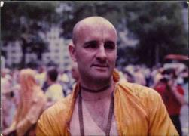
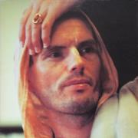
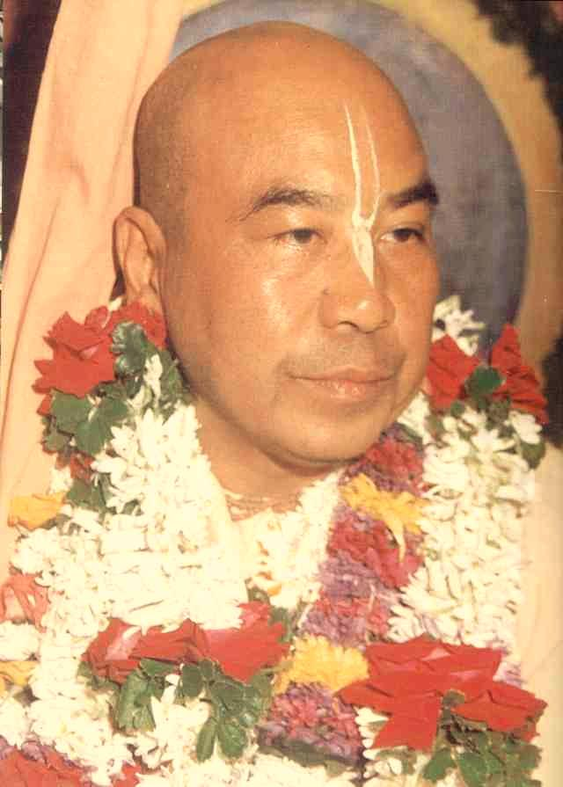
SB 3.13.4
Persons who hear from a spiritual master with great labor and for a long time must hear from the mouths of pure devotees about the character and activities of pure devotees.
It is therefore the duty of the transcendental students to hear of pure devotees, as explained by similar devotees of the Lord, because one cannot explain about the Lord or His devotee unless one happens to be a pure devotee himself.
Mutual Admiration Society
https://www.youtube.com/watch?v=aGsSAysEEug

Slide 9
God-brothers

Slide 10

SB 3.13.8
This line of disciplic succession from Brahmā is spiritual, whereas the genealogical succession from Manu is material, but both are on the progressive march towards the same goal of Kṛṣṇa consciousness.
Father
Mother

Slide 11
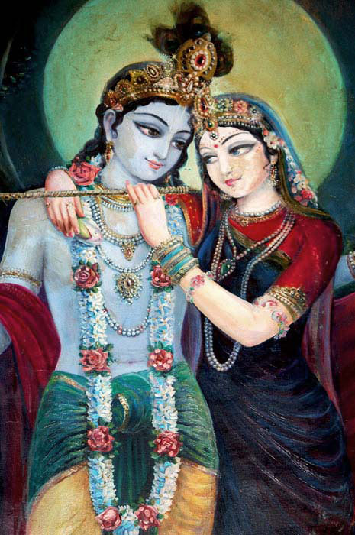
Bs 5.56 — I worship that transcendental seat, known as Śvetadvīpa where every tree is a transcendental purpose tree;
where the soil is the purpose gem, all water is nectar, every word is a song,
every gait is a dance, the flute is the favorite attendant,
where numberless milk cows always emit transcendental oceans of milk.
That realm is known as Goloka only to a very few self-realized souls in this world.

Slide 12
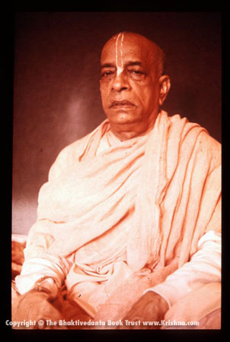

Sangat
Sanjayate
kamah

Slide 13
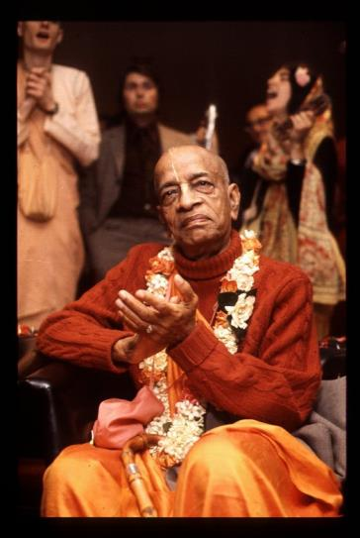

Thank you
AGTSP
www.JayaRama.us

