Slide 1

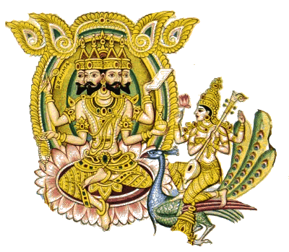
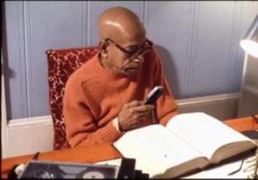
Srimad Bhagavatam 3.12.30
ISKCON Hawaii
Friday, 2016 May 5
Hanumat-presaka Swami
ISKCON Founder-Acharya
Srila A. C. Bhaktivedanta Swami Prabhupada

Slide 2

3.12.30
naitat pūrvaiḥ kṛtaḿ tvad ye
na kariṣyanti cāpare
yas tvaḿ duhitaraḿ gaccher
anigṛhyāńgajaḿ prabhuḥ

Slide 3

na — never;
etat — such a thing;
pūrvaiḥ — by any other Brahmā, or yourself in any previous kalpa; kṛtam — performed;
tvat — by you;
ye — that which;
na — nor;
kariṣyanti — will do;
ca — also;
apare — anyone else;
yaḥ — that which;
tvam — you;
duhitaram — unto the daughter;
gaccheḥ — would do;
anigṛhya — without controlling;
ańgajam — sex desire;
prabhuḥ — O father.

Slide 4

O father, this performance in which you are endeavoring to complicate yourself was
never attempted by any other Brahmā,
nor by anyone else,
nor by you in previous kalpas,
nor will anyone dare to attempt it in the future.
You are the supreme being in the universe, so how is it that you want to have sex with your daughter and cannot control your desire?

Slide 5
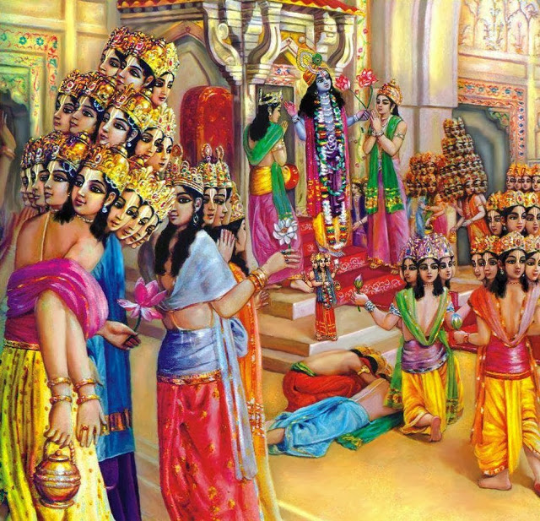
The post of Brahmā is the supermost post in the universe, and it appears that there are many Brahmās and many universes besides the one in which we are situated.

Slide 6
One who fills this post must be ideal in behavior, for Brahmā sets the example for all living entities.
Brahmā, the living entity who is the most pious and spiritually elevated, is entrust-ed with a post next to that of the Per-sonality of Godhead.

Slide 7
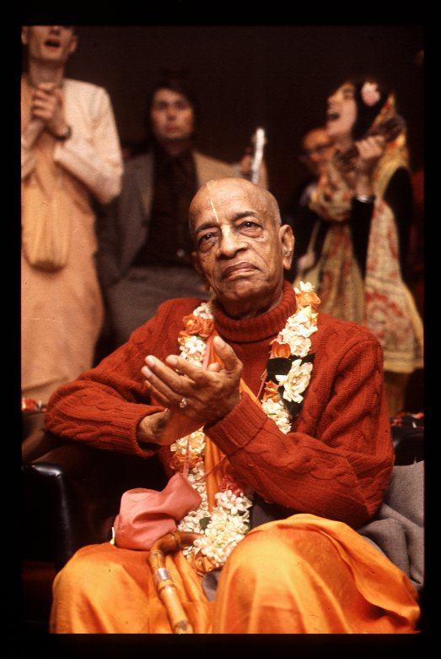

Thank you
AGTSP
www.JayaRama.us

